Slide 1
Assignment 1
This PowerPoint comprises the formal assignment specification.
Due Monday 2nd May @ 9.00 am
Worth 20% of your course mark.
Notes:
There is an additional handout with some required mathematical formulas on it.
We are doing it this way so that we can talk through the spec together, rather than just have you read it.

Slide 2
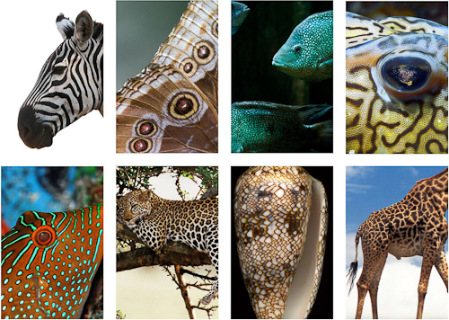
Mathematics and Computation in Biology
Notes:
http://n-e-r-v-o-u-s.com/education/simulation/ethworkshop.php “Reaction-Diffusion is a mathematical model of a theorized mechanism for biological pattern formation. “
Nature produces a wide array of complex yet regular patterns.
Biologists have determined that these patterns arise during embryonic development, but they still don’t know exactly how it all happens.
Because the patterns are so regular, they have often been considered mathematical problems – what formulas or equations could one produce that would explain how the patterns are developed.
For a long time (i.e. all the millenia before computers), proposed mathematical explanations were difficult to test – you make an equation, but then what? But with the advent of modern powerful computation, they are now testable through simulation. That is, you make your mathematical model, program it up as a prediction/simulation, let it run millions of times and see what happens.
This capability has advanced all of the hard sciences, and it has specifically shed some light on “how the leopard gets its spots”
One of the great things about being a coder is that you get to work on this stuff without having to have a biology degree. You just need to be able to understand the workings well enough to implement them.

Slide 3
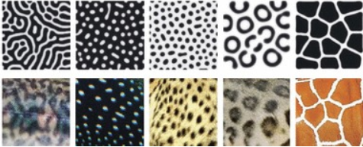
Gray-Scott Reaction Diffusion Models
Gray, P. and Scott, S.K., Chem. Eng. Sci. 38 29 (1983); 39, 1087 (1984); J. Phys. Chem.89 22 (1985).
Notes:
https://www.researchgate.net/figure/49645863_fig2_Figure-1-Reaction-diffusion-simulations-reproduce-color-patterns-found-in-nature-A
In the 1980’s Gray and Scott proposed a chemical mathematical model that they believed could explain how these animal patterns arise.
In the decades following, people were able to implement simulations of the model, and the patterns the simulations generated were remarkably similar to those found in nature.
In the image, you see animals in the bottom row, and patterns generated by the simulation in the top row.
The different patterns occur when the constants in the mathematical models are varied, as one would expect them to be in different animals.
Many people consider this to be evidence in support of the Gray-Scott diffusion model as an explanation for how the biological system works.
In your first assignment this semester, you are going to build a Gray-Scott simulator.

Slide 4
Diffusion-Reaction
Animal colouration is determined by the concentration of specific chemicals in the animal’s cells during embryonic development.
These chemicals spread out (diffusion) across the animal’s cells in a mathematically predictable way.
These chemicals react (reaction) with each other in a mathematically predictable way.
We will model a two-chemical system.
We will assign pixel colours based on the concentrations of these two chemicals.
We will observe the impact of varying equation parameters and algorithms on the patterns we generate.
Notes:
Very, very simplified...

Slide 5
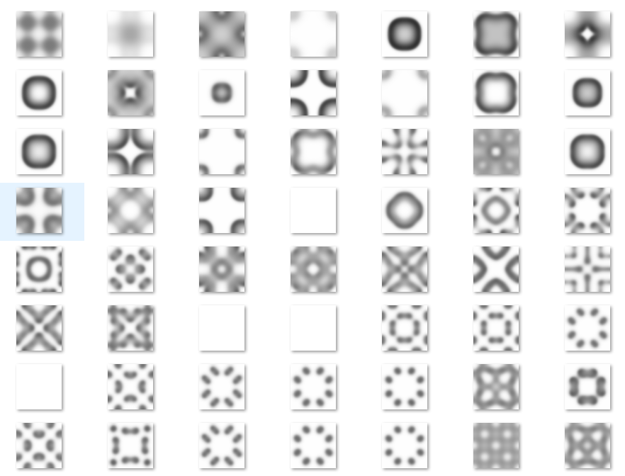
Examples
Notes:
From my solution, with different computational and shading algorithms...
These are 64 x 64 cell grids.
These all differ simply in the values of the equation parameters
This is what they look like when they reach a stable state
The different shades of grey represent different concentrations of the two chemicals in each grid cell
The plain white ones are where the stable state has one of the two chemicals completely taking over the whole grid.

Slide 6
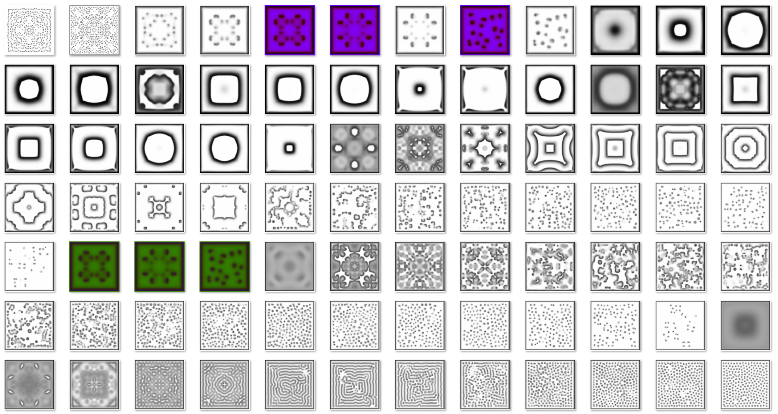
Examples
Notes:
From my solution, with different computational and shading algorithms...

Slide 7
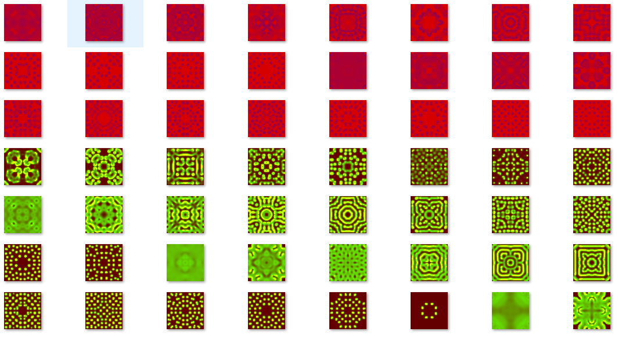
Examples

Slide 8
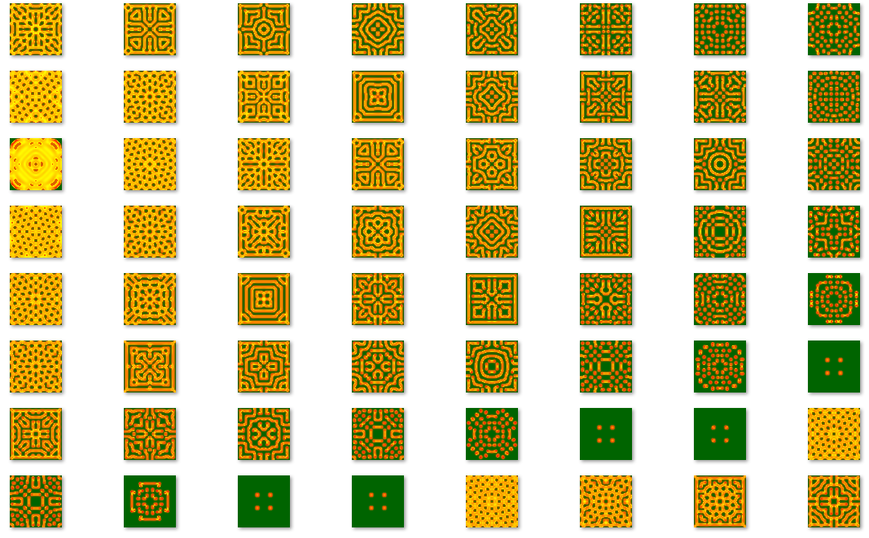
Examples
Notes:
Demo app...

Slide 9
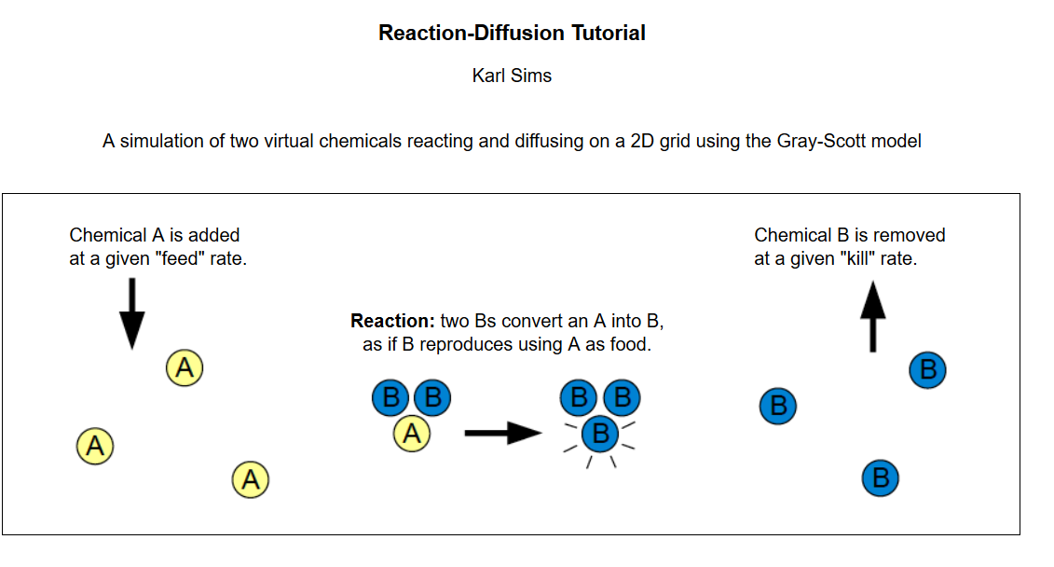
Gray-Scott
Notes:
http://www.karlsims.com/rd.html
Imagine the embryo as a collection of cells with a lot of chemicals swirling around in them. This is actually pretty realistic.
The model says that colouration is determined by the relative concentrations of just these two chemicals, A and B.
They swirl around and have chemical reactions, as shown.
The cell’s walls are permeable to A and B. Chemical A comes into a cell at some rate; chemical B exits the cell at some rate.
When they bump into each other in the right quantities, they have a chemical reaction => If two Bs and an A clump together, the A changes into a B (so you have three Bs).
Note that this immediately introduces some probability into the system → the more A there is, the more likely the Bs are to find it. So it is similar to predator-prey models, as indicated in the figure. Nature is parsimonious.

Slide 10
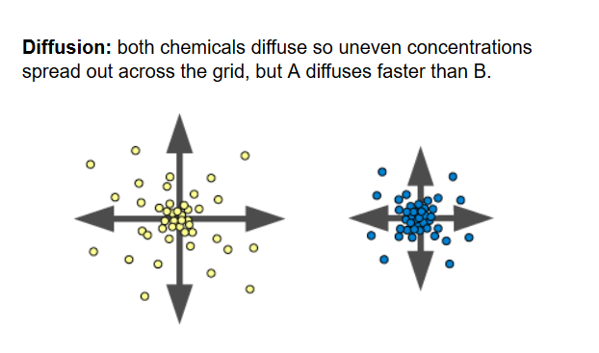
Gray-Scott
Notes:
At the same time all the reacting is going on, the chemicals diffuse by osmosis – the tendency of chemicals to want to spread out evenly.

Slide 11
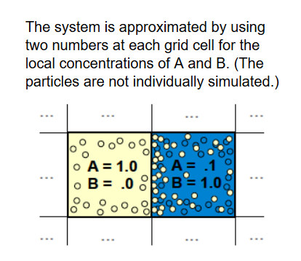
Gray-Scott Simulator
Notes:
To see the patterns, we only need to model the relative concentrations of A and B on a scale from 0 (none) to 1 (maximum possible)

Slide 12
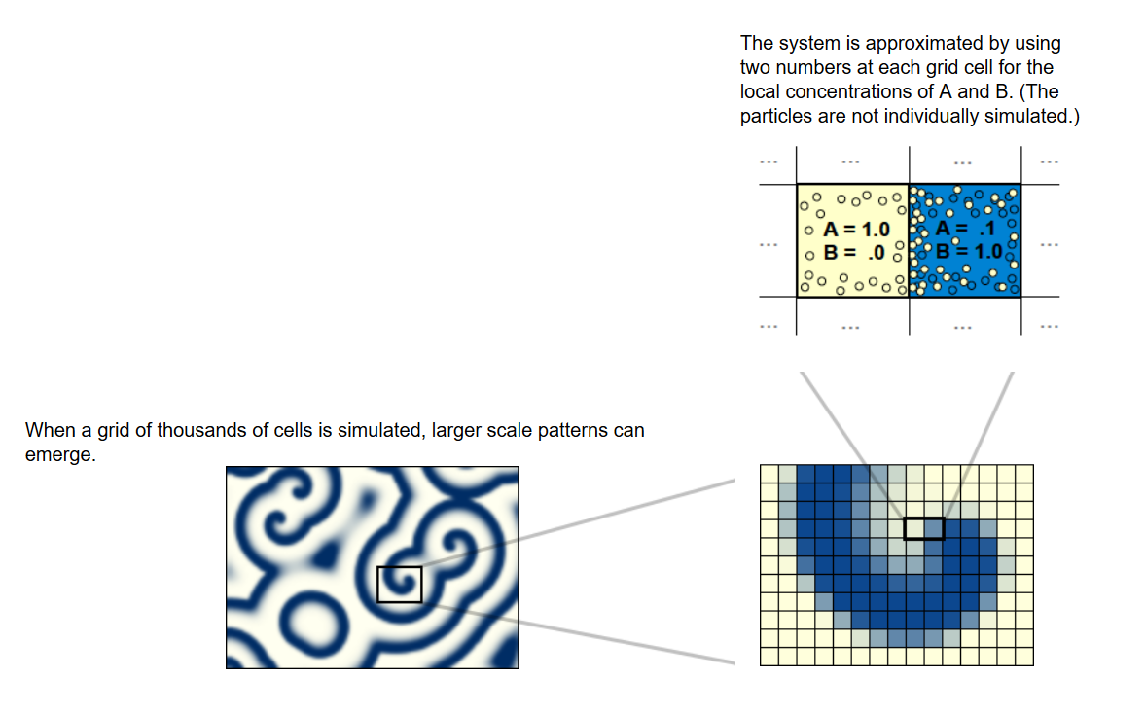
Gray-Scott Simulator
Notes:
This is what we are going to do.
We will build a grid of cells, determine the concentrations of A and B by using a formula and then colour the cells based on the concentrations of A and B.
The concentrations of A and B change over time as the chemicals feed in, die off, react and diffuse.
We will simulate time with a simple timer, updating the cells and their visual display at each timer tick.

Slide 13
The Equations
A_{t + 1} = A_{t} + (Diff_{A} * Lap(A_{t})) – A_{t}B_{t}² + (Feed_{A} * (1-A_{t}))
B_{t+1} = B_{t} + (Diff_{B} * Lap(B_{t})) + A_{t}B_{t}² – ((Kill_{B} + Feed_{A}) * B_{t})
Diff_{A}, Diff_{B}, Feed_{A} and Kill_{B} are simulation parameters.
They are set at the beginning of the simulation and do not change during that trial.
Lap(x) is the “Laplacian Function”, which is a measure of osmotic pressure (details in the handout).
Notes:
Lap(x) = “Laplacian function” which is a measure of osmosis. It is basically the difference between this cell’s concentration and the concentrations of its neighbours. If its neighbours are a lot lower than it, the chemical will diffuse fast. If its neighbours are nearly equal, it will diffuse more slowly. There are number of ways that mathematical biologists estimate this function. You will be given three different methods in the handout.
A and B are the concentrations of the two chemicals.
DiffA and DiffB are their diffusion rates
FeedA is the feed rate of A
KillB is the kill rate of B
The equations are actually pretty straightforward:
How much does A change?
It decreases by its diffusion, which that first term will compute for us. Just take that on faith.
The prob of 2 B and and A meeting up is A*B*B. When that happens, the A changes to a B, so we subtract this term.
Then we add in the feed rate, scaled by 1-A so that it can’t be bigger than 1 (because we are limiting our range to 0..1).
How much does B change?
The same, except that the reaction adds a B, and we subtract the Kill rate. (The addition of FeedA to KillB there just keeps the system from exploding).

Slide 14
The Equations
A_{t + 1} = A_{t} + (Diff_{A} * Lap(A_{t})) – A_{t}B_{t}² + (Feed_{A} * (1-A_{t}))
B_{t+1} = B_{t} + (Diff_{B} * Lap(B_{t})) + A_{t}B_{t}² – ((Kill_{B} + Feed_{A}) * B_{t})
At each timer tick, we compute the new values of A and B for each cell and re-colour the cells.
Eventually the levels of A and B will stabilise (no longer change). That’s what the animal would look like.
Different values of the parameters produce different stable patterns.
Notes:
Colouring algorithms in a minute
Stability happens at different points for different parameter values. Some stabilise

Slide 15
Implementation
An n x n grid of cells, 16 <= n <= 256
Each cell has a concentration of A and of B
Update the concentrations of each cell at each timer tick.
Two step process:
Compute the new concentration values for all cells
Update all cells
Simulation begins with all grid cells at A=1, B=0.
Seed a small area of cells with B=1, A=0
Notes:
You can get patterns with as little as 16x16, but the good ones require at least 64x64, and they continue to get better up to 256 x 256. Bigger than that takes too long to run.
Two steps because: The Laplacian formula uses the chemical concentrations of the neighbours, so it matters if you change as you go. Don’t change as you go.
The seeded area is often placed symetrically in the centre, but you should feel free to experiment with off-center areas, multiple areas, etc.

Slide 16
Parameter Values
Diff_{A} and Diff_{B} depend on which Laplacian function you use (see handout)
The following pairs of Feed_{A} and Kill_{B} values should generate interesting patterns for all three Laplacian function in 5000 time steps.
Feed _{A} | Kill_{B}
.025 | .056
.032 | .061
.021 | .058
Notes:
Use these for testing your implementation to see if it is making sense.

Slide 17
Additional Requirements
No group work
Three Laplacian functions (see handout)
At least three colouring algorithms (see next slides)
Appropriate user interface to allow manipulation of simulation parameters and display.
Facility for saving grids as image files.
Facility for automating simulations to explore the solution space.
Notes:
You’re going to need to look at the effects of the various combinations of parameter values. You won’t want to do this by hand...

Slide 18
Shading Algorithms
Use the .NET Graphics class.
Each cell is painted a single colour (FillRectangle)
Based on concentration of one of the chemicals.
Must convert a scalar (value between 0 and 1) into an RGB value.
Many, many available algorithms.

Slide 19
Shading Algorithms
Simplest: Grayscale
Let x = (Concentration of B) * 255
Let y = Floor(x)
Brush colour is RGB(y,y,y)

Slide 20
Shading Algorithms
More interesting
Converting Scalars to RGB Colormap https://www.particleincell.com/2014/colormap/

Slide 21
Architecture
Correct classes and interfaces (if appropriate)
Correct SRP
Correct Open/Closed
Correct modularity
Cohesive
Uncoupled
Strategy, Factory and Subject/Observer design patterns used (or not used) as appropriate.

Slide 22
Rubric
Component | Weight
Architecture | 30%
Code elegance and correctness | 30%
Commenting | 5%
Functionality & Robustness | 30%
User Interface | 5%
Notes:
“Robustness” = bugs

Slide 23
Submission Requirements
Deliverables:
Running implementation, written in C#
Word document showing image files for 10 distinct patterns, specifying parameter values, number of time steps and Laplacian algorithm used.
All work to OP GitBucket repo
Minimum of two commits each week.
Note that success with this assignment depends very heavily on carefully following the spec.
Note that after your simulator is working, you will need a lot of time (possibly several days) to run your automated trials to explore the solution space. Plan your schedule accordingly.
Notes:
To find your interesting patterns, you will need to explore the whole range of parameter values.
You will absolutely need to automate this.
If you haven’t done anything, that’s your commit message.
Read the spec very carefully. Plan ahead very carefully.

Slide 24
Permissible Googling
Do as much research into Gray-Scott and its implementations as you wish.
Submit ONLY original code.
Be prepared to explain your code in laborious detail if asked.
Notes:
No copy-paste
No robo-coding.

